Slide 1

Analysis of the Pet and Health Categories
November 2016

Slide 2
Agenda
Jet.com Overview
Why Jet?
Jet Growth and Competitors
Competitor Analysis
Associate, Category Management Position
Understanding Pet & Health Category

Slide 3
Jet.com Overview
Vision
We're all in it together.
We share a sense of community with our shoppers and our partners, and we’re striving to create a business model that reflects that.
We work collaboratively with our retail partners, not competitively.
Our pricing algorithm is designed to help our partners find ways to reduce inefficiencies, so they win too.
Savings smart and simple.
As a Jet shopper, you get real, meaningful savings when you shop—without a Herculean effort. And if you ever need anything, the Jet Heads are here to help 24/7.
Work transparently.
Play fairly.
Trust explicitly.
Values
We think openly sharing information and ideas empowers people to do amazing things.
We play hard and play to win, but never play games with what’s right or fair.
We believe people are good and believing that brings out the good in people

Slide 4
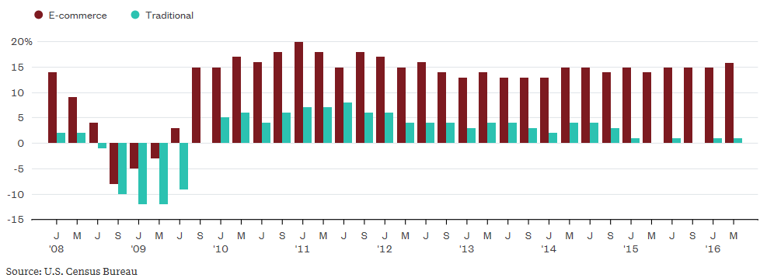
Why Jet?
Growth in Traditional Retail vs. E-Commerce¹
Poised for Growth
Customer Centric
Company Culture
The above graph shows the growth per month for the E-Commerce and Traditional retail industries
E-Commerce growth has consistently stayed strong, hovering around 15% growth since the end of the recession
E-Commerce growth has been 3x - 4x higher than Traditional retail since Q3 2012
Total investment in E-Commerce has grown from $1.2B in Q4 2011 to $5.3B in Q3 2016²
Pushing E-Commerce Disruption
`
Opportunity for Process Ownership
“I quit Prime after realizing I could get most items cheaper on Jet, and that I didn't really need Prime's other features.”³
¹Graph Source: https://www.bloomberg.com/gadfly/articles/2016-08-17/macy-s-and-other-retail-store-closings-have-silver-lining; ²cbinsights.com (E-Commerce); ³Quote Source: http://www.businessinsider.com/jet-vs-amazon-prime-2016-8;

Slide 5






Jet.com Investment and Growth Overview
$5M Series A II
Attained valuation of >$1Bn
$5M LoC
$15M Debt
$500M Series B
$55M Series A
$20M Debt
$125M Convertible Note
Acquired for $3.3 Bn by
Founded Jan 2014
Jet.com officially launches
2014
2015
2016
Competitors¹
Direct to Consumer
Mkt Cap: $380 Bn
Value add: Dash buttons, additional services for paid membership, household name, Amazon-created products
Valuation: N/A
Total funding: $132.6M
Value add: focus on mobile, warehouse club concept, cash rewards or all purchases, has a private-label brand
Mkt Cap: $16.3B
Value add: conglomerate structure, growth through acquisition (Buy.com to enter the US)
Mkt Cap: N/A
Value add: Branded items, potential discounts specific to each company, “outlet” options, specific options for customers
¹eBay was removed from the competitor list because it seems to function more as a “one-off” purchasing site (excellent for the auction-system of purchasing unique goods)

Slide 6

Customer Experience Features – Jet vs. Competitors
Company | Features / User-Friendly Experiences
 | Additional Discounts | Bundled Purchases | Cost to Use | Returns / Seller Comm. | Convenience / Ease of Use | Q&A / Comments
Direct to Consumer / In-Store
¹On each site, attempted to navigate to a “Dog Toys” section without using a search feature

Slide 7
Associate, Category Management Position
Roles & Responsibilities¹
Project Experience²
Relevant Responsibilities
“The Associate, Category Management will be based in our HQ office in Hoboken and responsibilities will include:
Assist in developing assortment strategy for a product category
Setup and maintain product data in the Jet catalog to drive conversion rates
Manage on-site product presentation and identify opportunities to improve the search/browse experience
Conduct regular reporting and analysis of category performance, identifying key trends improvement opportunities
Conduct analyses to assist with product sourcing strategy
Take ownership over category and assortment enhancement projects from the hypothesis phase through execution
Work with cross functional teams (across marketing, product and customer experience) to execute initiatives to optimize category performance”
Project Growth: Developed a growth strategy for the Asia Pacific region to boost client acquisition, working with HR, marketing, and data teams
Global Financial Reporting Platform and Analysis: Developed a globally uniform financial performance platform, managed all data and inputs, and performed analysis to monitor performance and recommend improvements
Sales Strategy Tool Development: Devised a way to create a sales improvement tool by analyzing all US product sales and developing a revenue prediction model
Voice of Client KPI Development: Managed a team of three developers to produce an automated set of KPIs to allow senior leadership to easily assess customer satisfaction and recommend region-specific changes
CEO Presentations: Developed management presentation for high-level officers at Citi, owning analysis, visuals, and talking points for senior leadership to communicate across Citi
3
6
7
1
2
2
3
3
4
6
4
2
4
6
5
6
2
6
7
7
2
3
7
¹Information on Roles & Responsibilities gathered from the “Associate, Category Management” Position posting on Jet.com; ²Not all qualifications in this category are listed on resume due to space reasons

Slide 8
Jet.com Pet & Health Categories
Health & Beauty
Pet Supplies
Total Subcategories | 13 + Deals + Wholesale
Subcategory Names | Skin care Hair care Makeup Fragrance Personal Care Health care Vitamins & Supplements Sport Nutrition & Diet Sexual Wellness Medical Supplies & Equipment Nail Care Hair Tools & Accessories Beauty Tools & Accessories
Listed as… | #4 on the “Categories” drop down menu
Total Subcategories | 8 + Deals + Wholesale
Subcategory Names | Dog Supplies Cat Supplies Bird Supplies Fish & Aquatic Pet Supplies Small Animal Supplies Horse Supplies Insects (no further subgroups) Reptile & Amphibian Supplies
Listed as… | #6 on the “Categories” drop down menu
Search Notes:
Not all subcategories reacted the same when searched (some would have more specific suggestions listed first, then get more broad while others would be broad then get more specific) – typical case: search “sun care” / atypical case: search “cat food”
Each search only returned 21 pages of 24 products a piece (504 options), but showed broader categories having 10,000+ products available (e.g., Personal Care)

